Slide 1

Phase-XV Applying ML and DL algorithms Training / Inference in noisy environments and incomplete data
Guided by: Dr. Sabah Mohammed
Mohan Prasad Kutala
mkutala@lakeheadu.ca

Slide 2
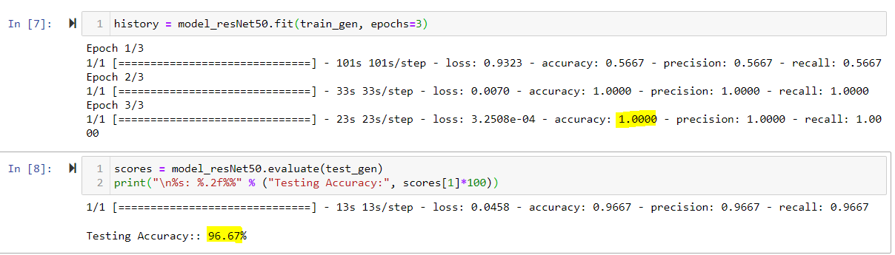
ResNet50V2 for Pneumonia
ResNet50V2 is a modified version of ResNet50 that performs better than ResNet50 and ResNet101 on the ImageNet dataset.
The ResNet50V2 architecture consists of several residual blocks with each block having several convolutional operations. The implementation of skip connections makes the ResNet50V2 better than VGG.
I took sample dataset having 35 images to select the algorithms (ResNet50v2 [train: 100; test: 96], DenseNet201 [train: 59; test: 40], VGG16 [train: 33; test: 90] and PyTorch [train: 76; test: 66])

Slide 3
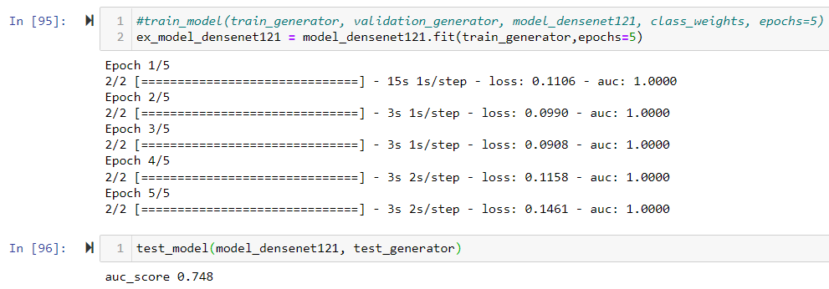
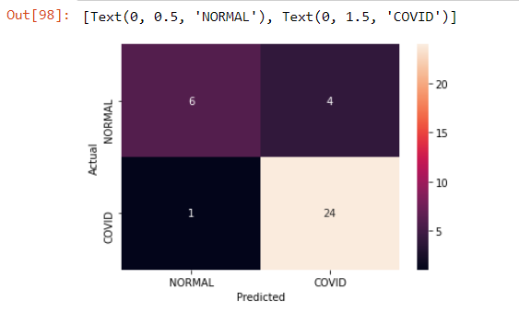
DenseNet121 for Covid-19
DenseNet is a convolutional neural network where each layer is connected to all other layers that are deeper in the network, that is, the first layer is connected to the 2nd, 3rd, 4th and so on, the second layer is connected to the 3rd, 4th, 5th and so on.
I took sample dataset having 35 images to select the algorithms (DenseNet121 [train: 100; test: 74], ResNet50 [train: 31.43; test: 28.57], VGG16 [train: 50; test: 71] and PyTorch [train: 96; test: 71])

Slide 4
